Slide 1

Returning to school – how it will work

Slide 2

Returning to school – how it will work
Before you leave your house
Wear clean clothes every day – your uniform is fine or you can wear a t-shirt and shorts or leggings or joggers. Wear your trainers too.
Make sure that you have your coat, hard lunch box and water bottle. Everything you take to school will stay on your table in your classroom.
Don’t worry about your PE kit – you’ll be doing that without getting changed.
Wash your hands before you leave.
Where possible, avoid public transport. Give yourself extra time and walk or cycle to school.

Slide 3
Returning to school – how it will work
Arriving at school
Each year group will arrive at different times. If you are in Year 6 you will arrive at 8.45am; Year 1 at 9am; Reception at 9.15am; Nursery at 9.30am.
Your will need to arrive on time and you can’t wait with other families.
If you’re a little early you must stand away from other people. This is very important.
A teacher will then call you in to school – follow the red markings to make sure you don’t get to close to anyone else.

Slide 4
Returning to school – how it will work
Getting back to normal
It’s really important to us that you feel happy and safe at school.
If you are upset by anything, tell the adult in your room and we’ll help you.
Mrs Swaysland and Mrs Newington will be on hand most of the time so you have someone to speak to if you are upset or worried about your family.
Work hard, be kind, challenge yourself!

Slide 5
Returning to school – how it will work
Entering your classroom
As you enter school, you will be told which way to go and you’ll need to enter your classroom from the door outside.
Your teacher will give you a squirt of hand sanitizer and then tell you which seat or space to sit in.
You will then be asked to wash your hands. Your teacher will tell you when it is your turn.

Slide 6

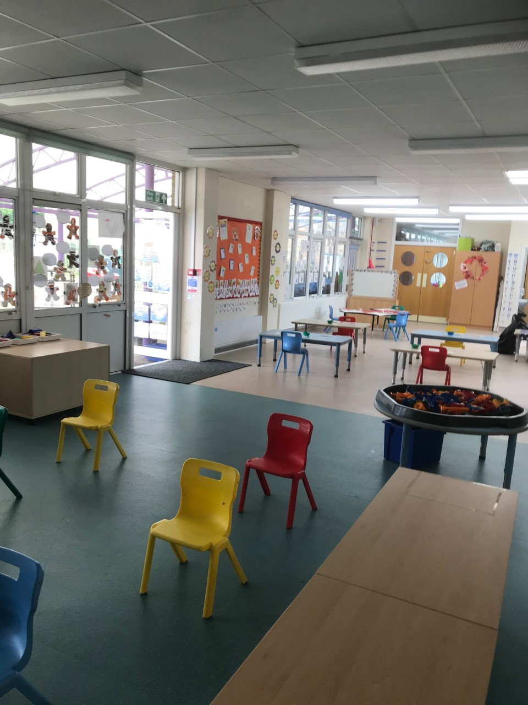
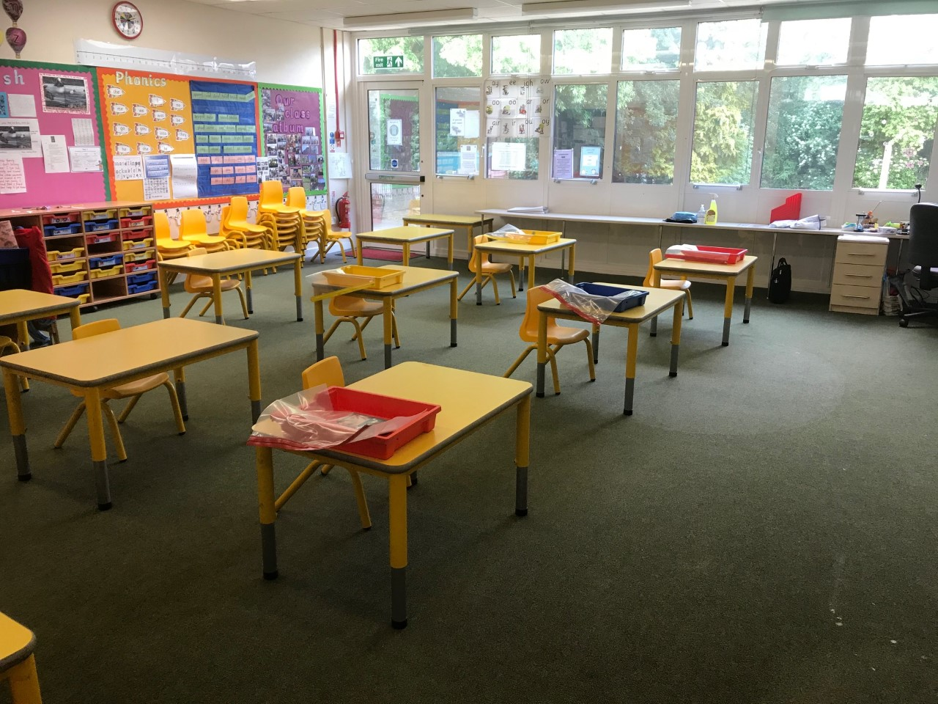
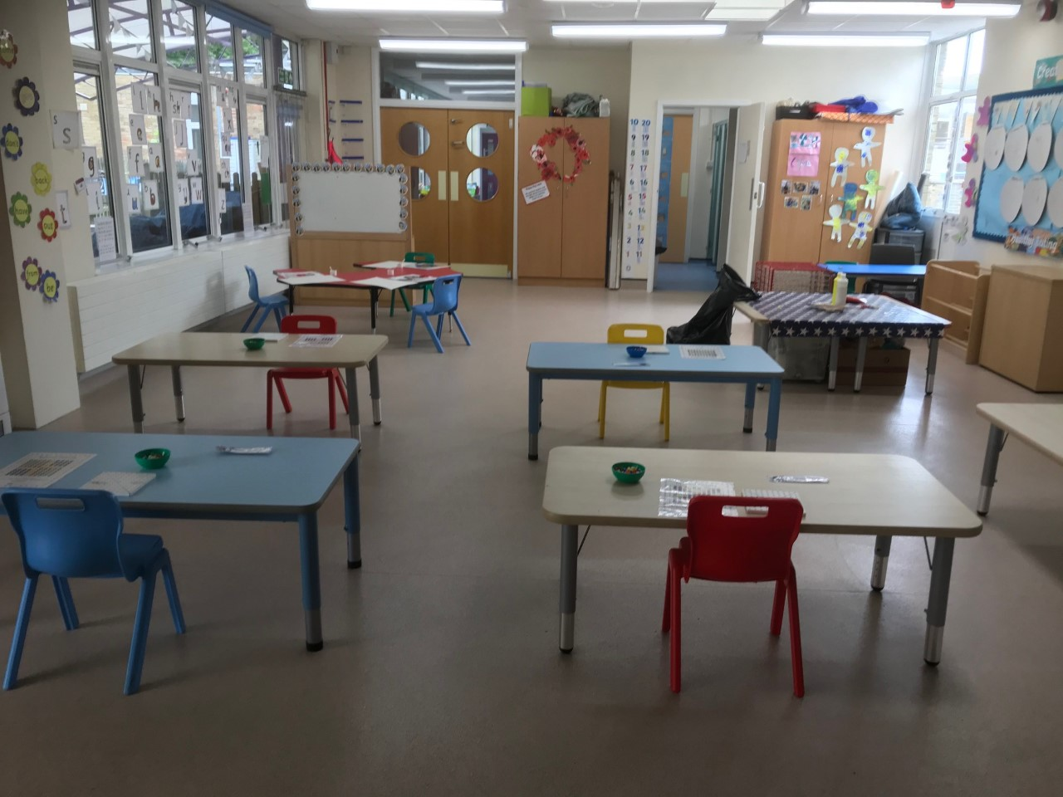
Returning to school – how it will work
The classroom layout

Slide 7
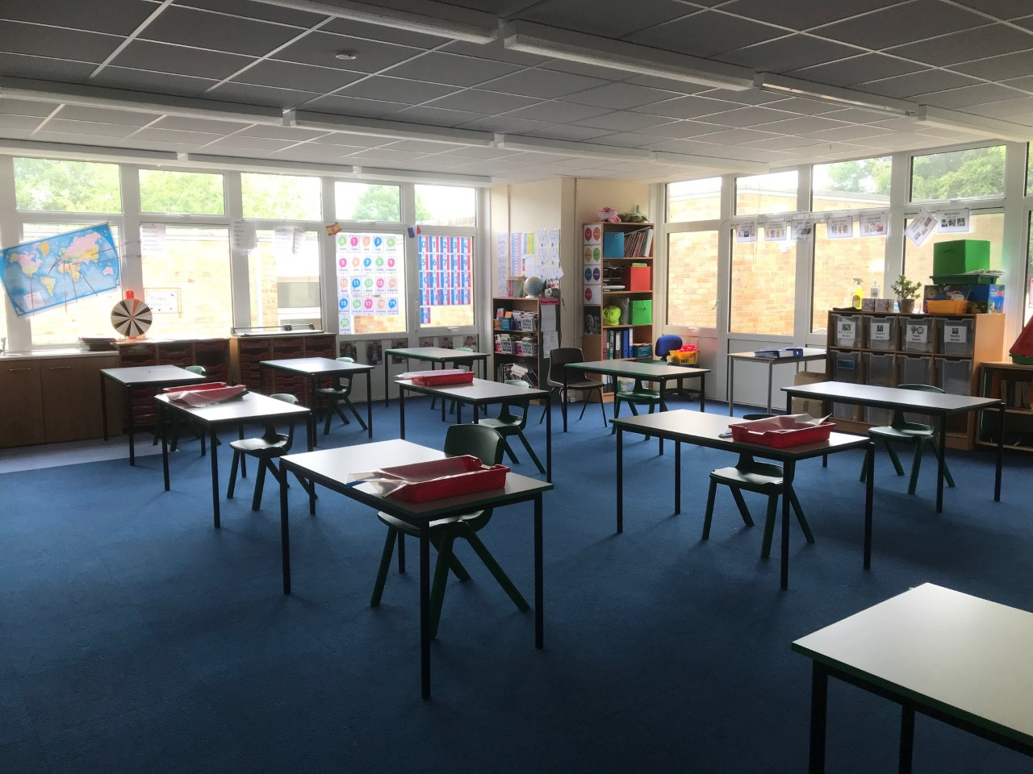
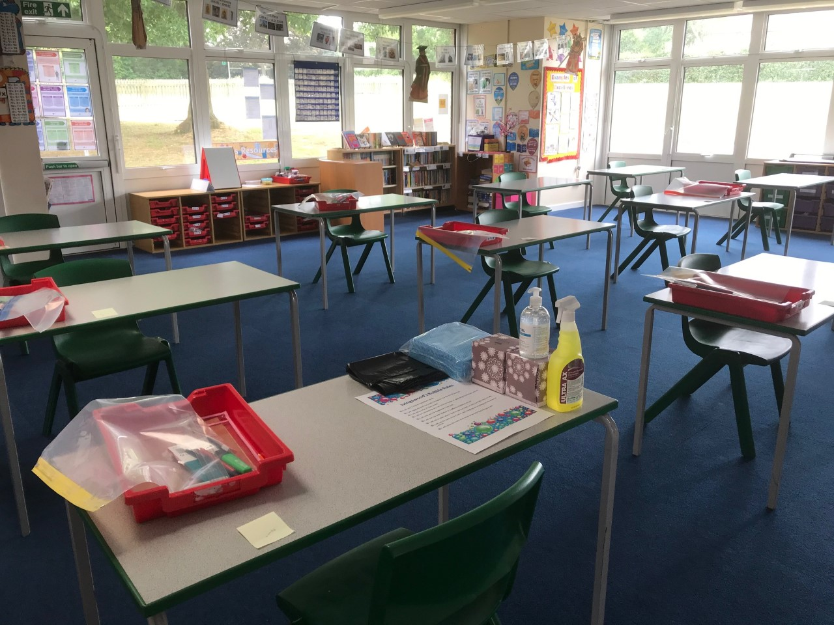
Returning to school – how it will work
The classroom layout

Slide 8
Returning to school – how it will work
Inside the classroom
You will have your own equipment waiting on your table for you, don’t use other people’s equipment.
A lot of lessons might take place outside!
Stay in your seat at all times – put your hand up if you need the teacher.
If you need the toilet, you can go, but you must ask first and not spend time with other children. You must also wash your hands.
If you need to cough or sneeze then you must ‘catch it, bin it, kill it’.

Slide 9
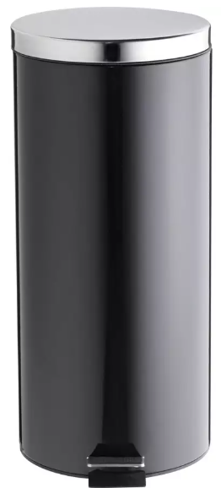
Returning to school – how it will work
Catch it, bin it, kill it!
‘Catch it’ means you sneeze in a tissue or your elbow.
‘Bin it’ means you put your tissue in the bin as soon as possible.
‘Kill it’ means you wash your hands.
There will be tissues and a special bin in your classroom so you can safely throw away your tissues.

Slide 10
Returning to school – how it will work
Lessons
Your teacher will prepare lessons like you normally have in school.
You must try your hardest – we still expect you to ‘work hard’
If you’re struggling, then the teacher will come to you, but don’t get out of your seat unless the teacher calls you.

Slide 11

Returning to school – how it will work
Breaktime
You will still have your break times outside but it might not be where you normally play.
You can only play with children that are in your group and you have to try to distance yourself still.
When you come in from break, you must wash your hands.

Slide 12
Returning to school – how it will work
Lunchtime
Everybody will eat lunch in their own seat. Once you have finished lunch, an adult will take you outside to play. Grab bags will be brought to your room.
If you fall over at lunch or break and you need first aid, an adult will help you but they might be wearing some different clothes (I’ll tell you more about that).
When you come in from lunch, you must wash your hands.

Slide 13
Returning to school – how it will work
If you feel unwell
If you have a temperature, a new cough, or lose some sense of taste or smell, then you must tell an adult.
Someone will take you to Narnia to make sure you’re ok and your parents will be called to collect you.
The adult looking after you might be wearing different clothes that help them to keep germs away.

Slide 14
Returning to school – how it will work
Personal Protective Equipment (PPE)
If you feel unwell or teachers have to help with first aid, they might wear some strange clothes so that you can all stay safe.
Adults might wear a mask, gloves, an apron or even a face shield.
Behind the PPE is one of your teachers and it is completely normal. You might have seen lots of people wearing gloves or masks at the supermarket already.

Slide 15
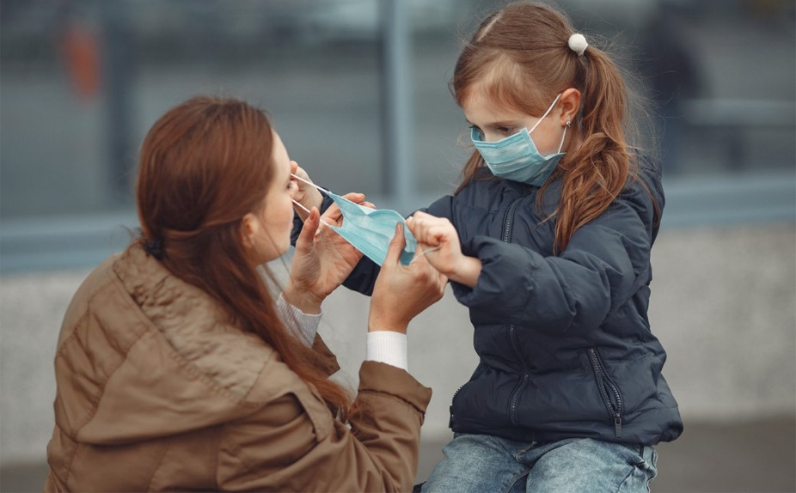
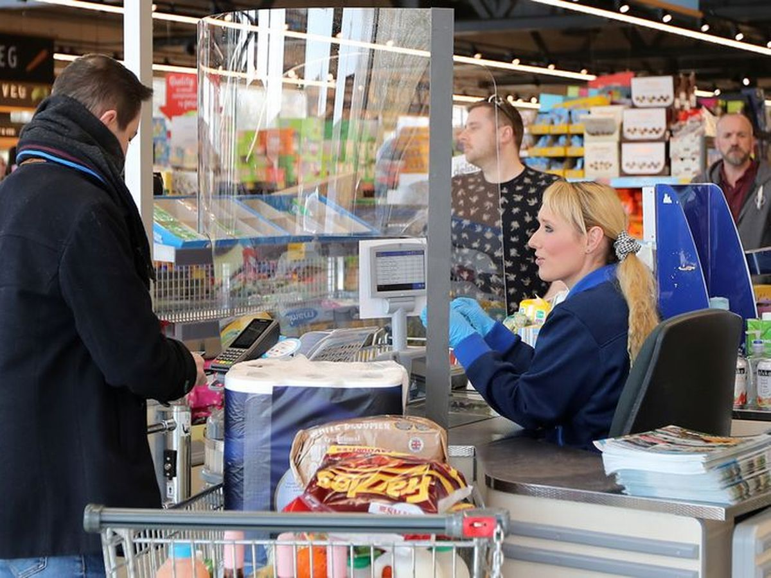
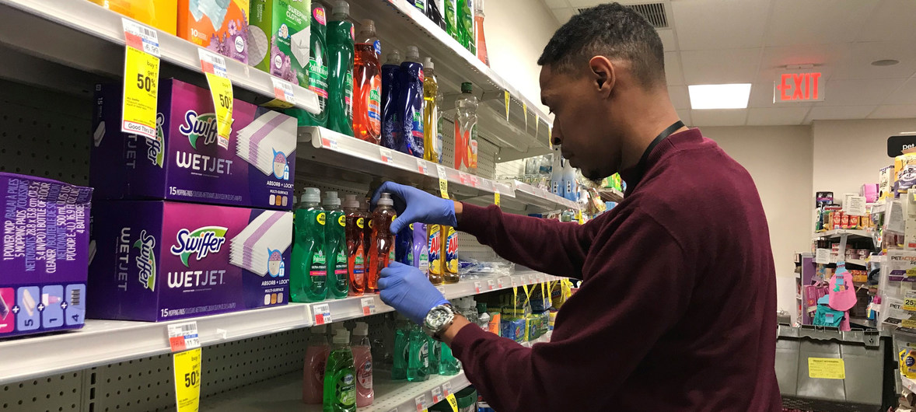
Returning to school – how it will work
Personal Protective Equipment (PPE)

Slide 16
Returning to school – how it will work
Leaving school at the end of the day
Year groups will leave school at different times. Nursery will be collected at 11.30am. Reception and 1.15pm; Year 1 at 1.30pm; Year 6 at 1.45pm.
Before you leave you must wash your hands.
Your teacher will tell you when you are to leave the room. Reception will meet their parents in the outdoor area and Nursery and Year 1 will meet their parents on the playground.
When you leave with your parents or carers, you must not mix with other children.

Slide 17
Returning to school – how it will work
When you get home
Wash your hands as soon as you get in your house.
Tell your parents or carers about your fantastic day.
Fall asleep on the sofa because you’ve worked so hard all day!

